Slide 1


Languages matter – now more than ever!
European Centre for Modern Languages
of the Council of Europe
ECML
Centre européen pour les langues vivantes du Conseil de l‘Europe
CELV
Europäisches Fremdsprachenzentrum des Europarates
EFSZ

Slide 2
Council of Europe
Established on 5 May 1949 (Treaty of London) by 10 states
Comprises 47 member states today
Based in Strasbourg (France)
Intergovernmental political Organisation,
founded on three main values:
human rights, democracy and the rule of law
47 MEMBER STATES
820 MILLION EUROPEANS

Slide 3
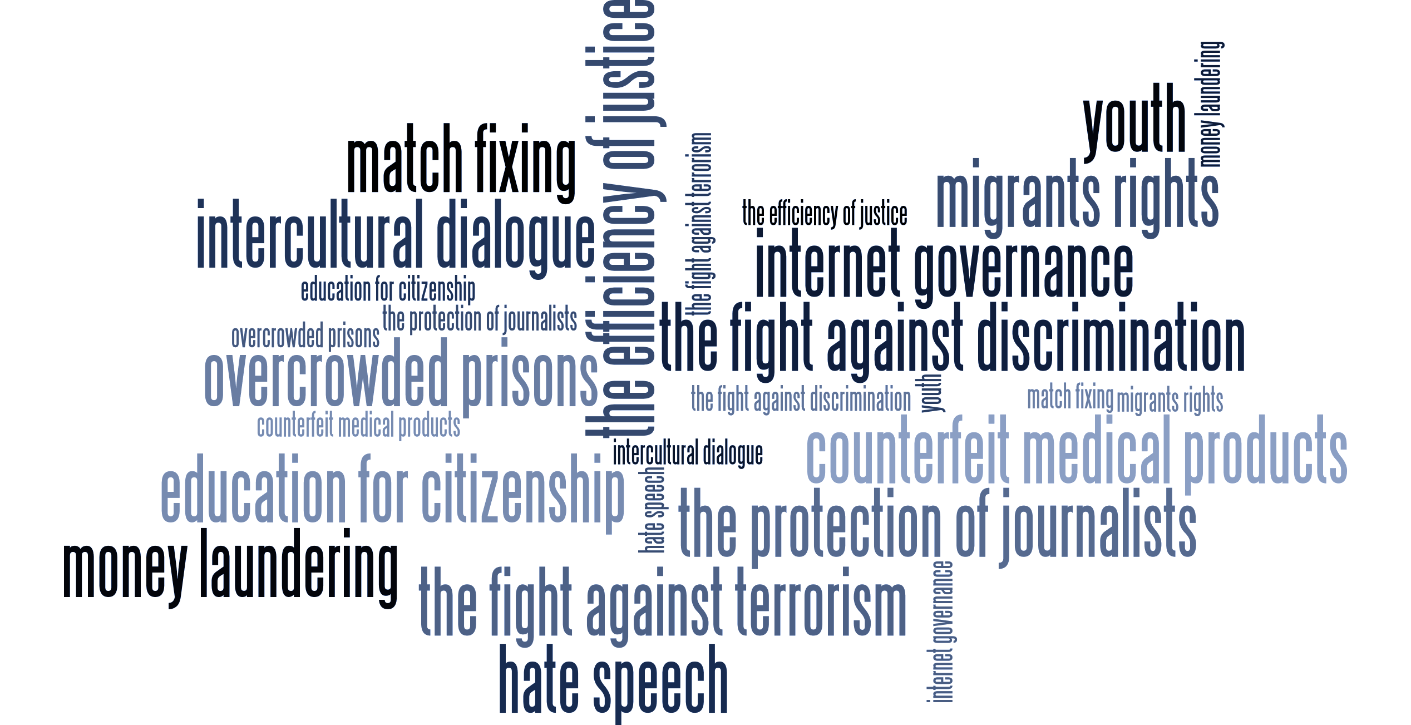
47 MEMBER STATES
820 MILLION EUROPEANS
The Council of Europe

Slide 4
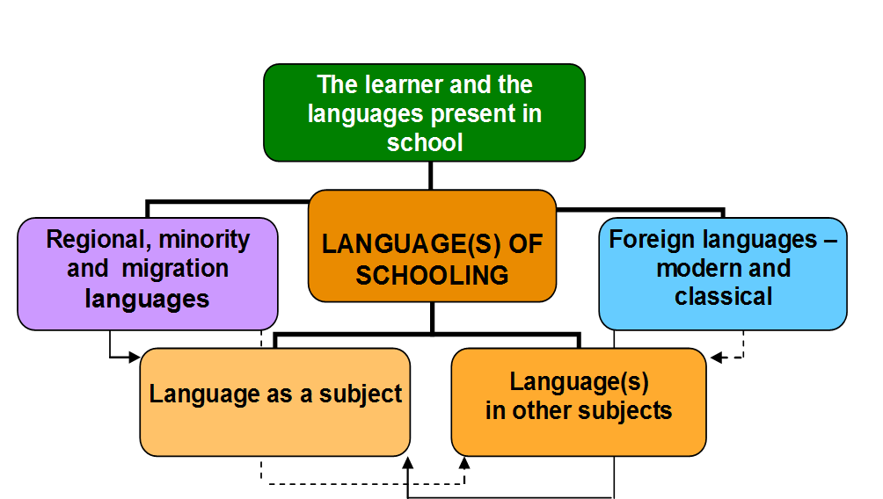
The Council of Europe and languages
Language education contributing to democracy
Curricula and evaluation
http://www.coe.int/t/dg4/linguistic/langeduc/le_platformintro_EN.asp

Slide 5
ECML: who we are and what we do
An enlarged Partial Agreement
of the Council of Europe with 33 member states; founded in Graz, Austria in 1994
Mission
innovation in language learning and teaching; implementation of effective language education policies
Key target audience
decision-makers, teacher-trainers, language teachers
4 year programmes
of international projects and bilateral training and consultancy
Our vision
A Europe committed to linguistic and cultural diversity, where the key role of quality language education in achieving intercultural dialogue, democratic citizenship and social cohesion is recognised and supported.

Slide 6
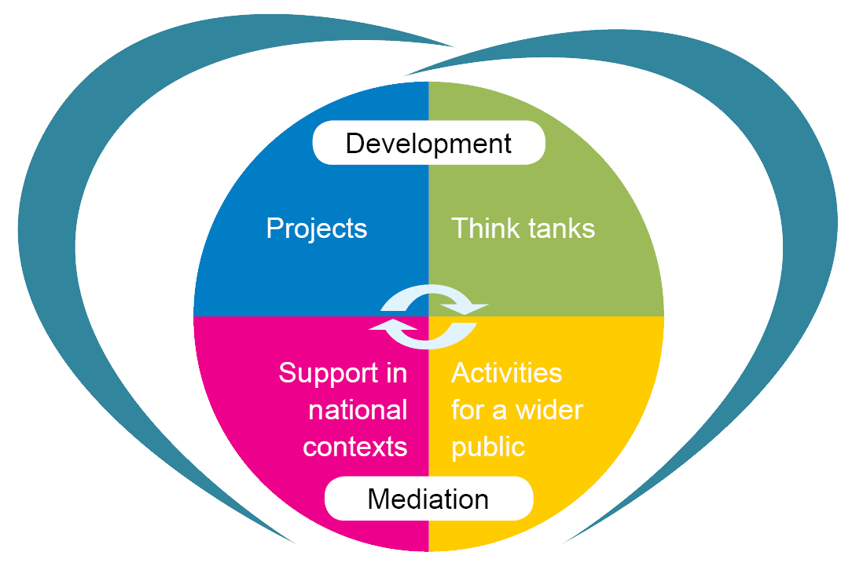


ECML Programme 2016-2019
Languages at the heart of learning
Digital literacy
Adult migrants
Sign languages
Early language learning
CEFR implementation
Whole-school approaches to the language of schooling
Language in subject learning
Language teacher competences
Language learning pathways
Language learning environments
Action research
Training and consultancy
National support events
Colloquia/conferences
Colloquia/conferences
Notes:
.

Slide 7


ECML training and consultancy for member states
  Targeted, tailored support to address national challenges
Supporting Multilingual Classrooms*
Plurilingual education
Testing and Assessment (RELANG)*
Quality education in Romani
Quality assurance in language and citizenship courses
Language teacher education
Content and Language Integrated Learning
Use of ICT in support of language teaching and learning
Plurilingual and intercultural learning through mobility
Using the European Language Portfolio
* in cooperation with the European Commission

Slide 8
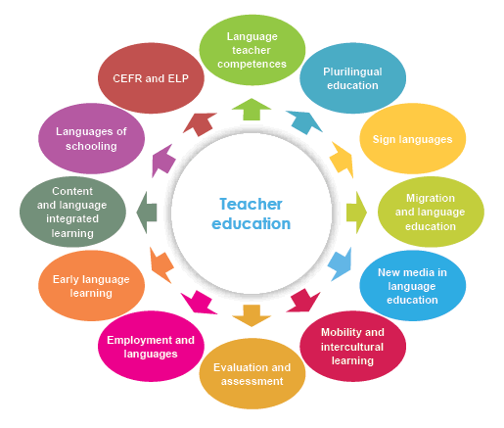
ECML Thematic Areas

